Slide 1
Project Progress Report
DOT Traffic Ops database migration project
Jason Wu, Hyunsoo Lee

Slide 2
Background, Goals, Objectives
Background: The current database that NYC DOT Traffic Ops is using to store relevant information on crossing signals is slow to respond to input, takes up excessive and redundant storage, is user unfriendly, and requires dedicated maintenance.
This project intends to resolve this problem by creating a new online database and User Interface that will replace the existing database and UI and port over all existing data.

Slide 3
Updates
We have implemented partial functionality for logging in, logging out, and signing in for the front end. The UI for this is relatively simple and we intend on fleshing it out with some CSS.
Screenshot for this is in the next slide.

Slide 4
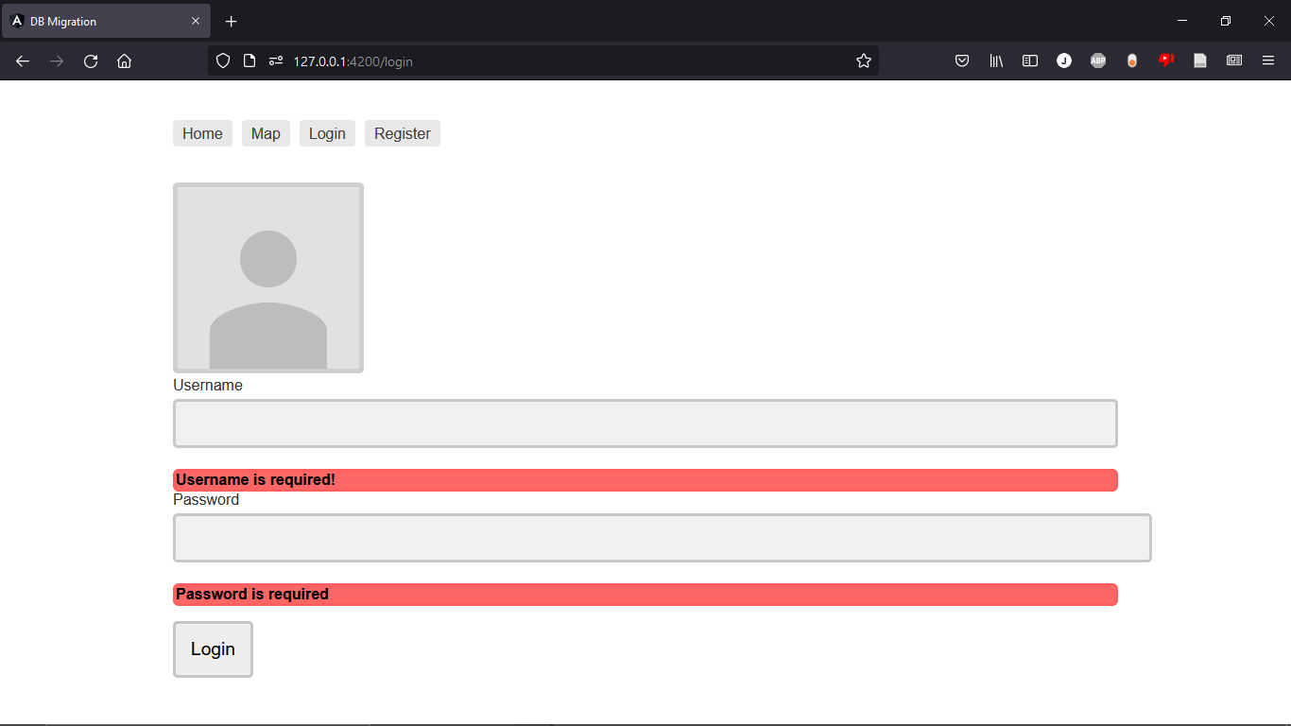
Screenshots

Slide 5
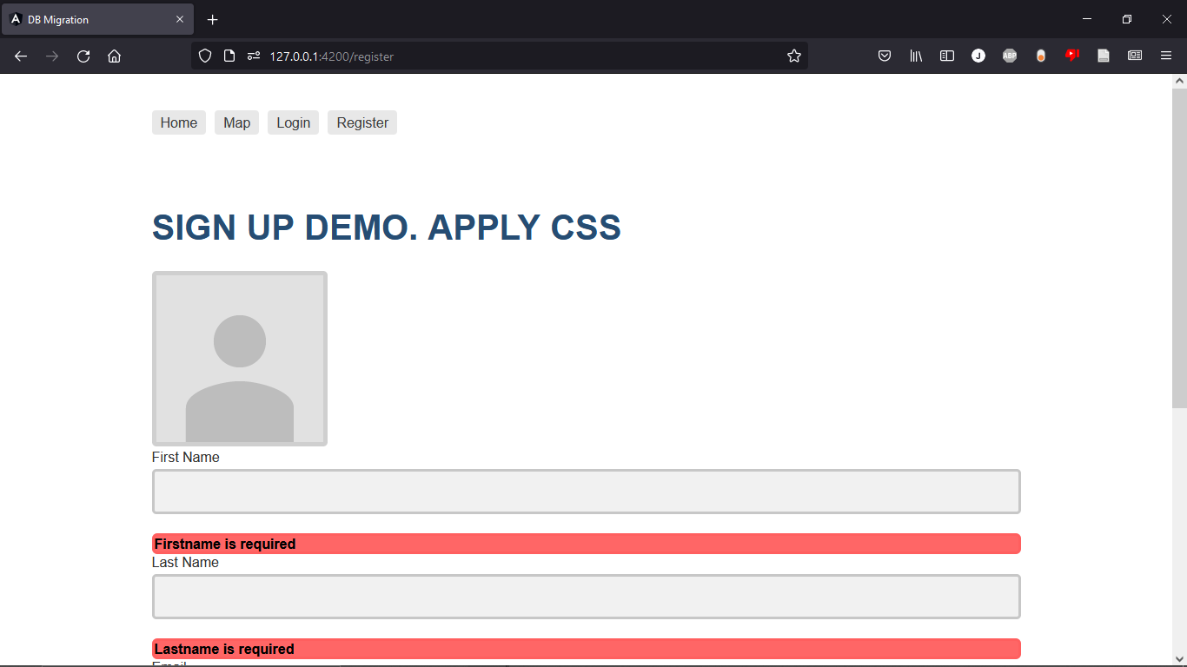
Screenshots

Slide 6
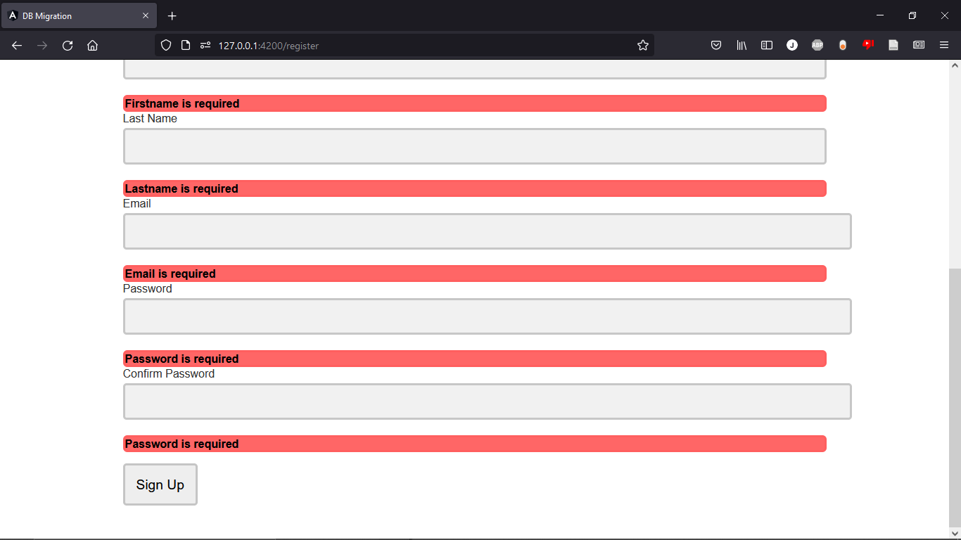
Screenshots

Slide 7
Timeline(front-end)
Timeline(back-end)
Improve authentication system (login, logout and register) - April 12
Implement role-based authorizations - April 13
Implement functions for other borough(Brooklyn, Queens, The Bronx, Staten Island) - April 19
Implement Create, Read, Update and Delete (CRUD) for data management - April 25
Make the website look better with CSS - April 26
Admin page design - May 10
Change settings for production mode - May 14
Improve authentication token management
Handle large amounts of concurrent API requests
Implement APIs for whatever the front-end needs
Finish migrating data
Edit database schemas for data efficiency

Slide 8
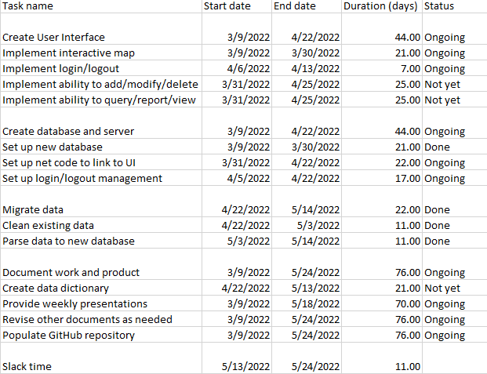
Current work breakdown

Slide 9
Questions, contact
Contact info (Jason Wu):
(347)274-4302, zehong.wu@macaulay.cuny.edu
Contact info (Hyunsoo Lee):
hsleenet@gmail.com

Slide 10
Communication Plan
Name | Title | Frequency | Format, Channel | Notes
Maddalena Romano | Sponsor, Stakeholder | Weekly | Presentations via Zoom, other issues via email
Bill Harrison | Stakeholder | Asynchronous | Presentations via Zoom if present, other issues via email as needed
Type | Method | Frequency | Goal | Owner | Audience
Progress Report | Presentation via Zoom | Weekly, every Wednesday | Inform audience of the state of the project as of each report | Project Managers | Stakeholders, Customers

